Slide 1







IBM Data Analytics Capstone Project – Final Representation
Mina Tawfik Danial
23 / 10 / 2023

Slide 2



OUTLINE
Executive Summary
Introduction
Methodology
Results
Visualization – Charts
Dashboard
Discussion
Findings & Implications
Conclusion
Appendix

Slide 3

EXECUTIVE SUMMARY
Trends in programming languages and databases
Current Technology Usage
Top 10 Languages Worked with
Top 10 Database Worked with
Platform worked with Word-Cloud
Top 10 Web-frame Worked with
Future Technology Trend
Top 10 Languages Desired Next Year
Top 10 Database Desired Next Year
Top 10 Web-frame Desired Next Year
Platform worked with Desired Next Year
Demographics

Slide 4

INTRODUCTION
Analyzing the trends in software development
Purpose :
Identify skill requirements for future
What are the top programming languages in demand?
What are the top database skills in demand?
What are the popular IDEs?
• Audience: Human Resource and IT Head

Slide 5

METHODOLOGY
Collecting Data
Stack Overflow Developer 2019 Survey
GitHub Job Postings Using API and Web-scrapping.
Programming Languages Annual Salary Using API and Web-scrapping.
Exploring Data
Finding Duplicates & Removing Duplicates.
Finding & Imputing Missing Value.
Normalizing Data.
Handling Outliers.
Correlation
Visualization Data
Visualization Distribution, Relation, Composition & Comparison of data.
Building Dashboard.

Slide 6
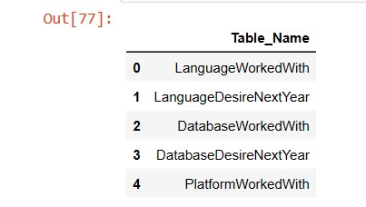
RESULTS
The Results are based on these tables:

Slide 7
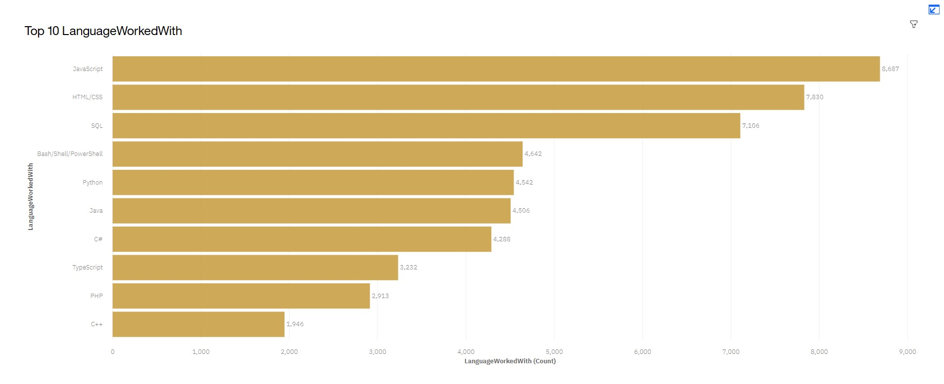
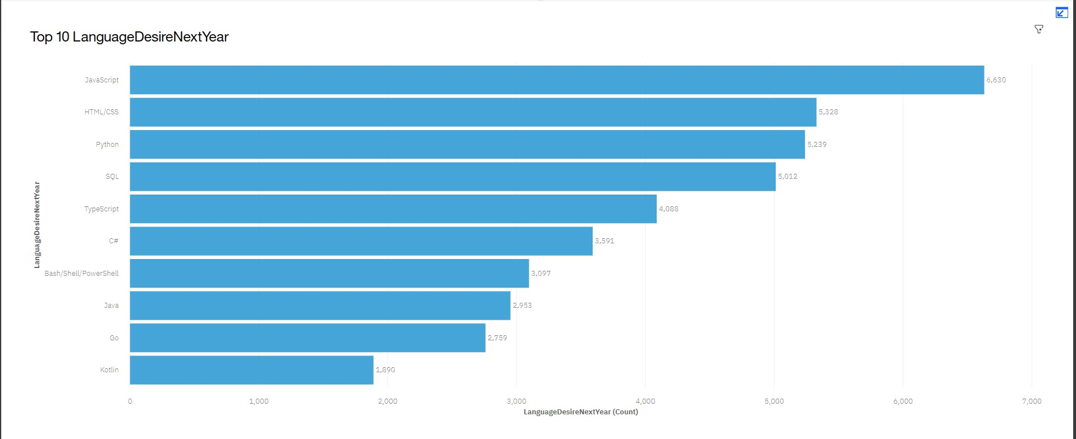
PROGRAMMING LANGUAGE TRENDS
Current Year
Next Year

Slide 8
PROGRAMMING LANGUAGE TRENDS - FINDINGS & IMPLICATIONS
Findings
JavaScript, HTML/CSS, SQL are top 3 this year
Web Assembly comes as least popular for current years and VBA appears least choice for next year
Python and Typescript becoming popular next yea
Implications
Web Assembly and VBA has been replaced by other programming languages at most places.
Java-script is becoming the new upcoming popular demanding programming language among users
With AI and ML in rising demand, Python is best choice

Slide 9
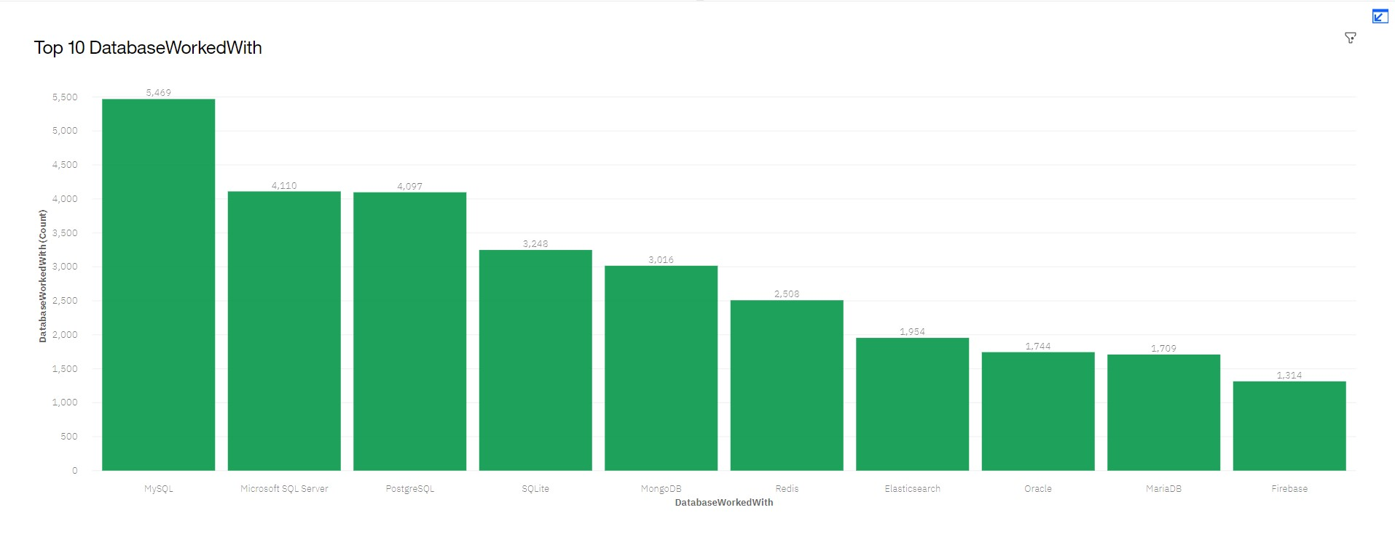
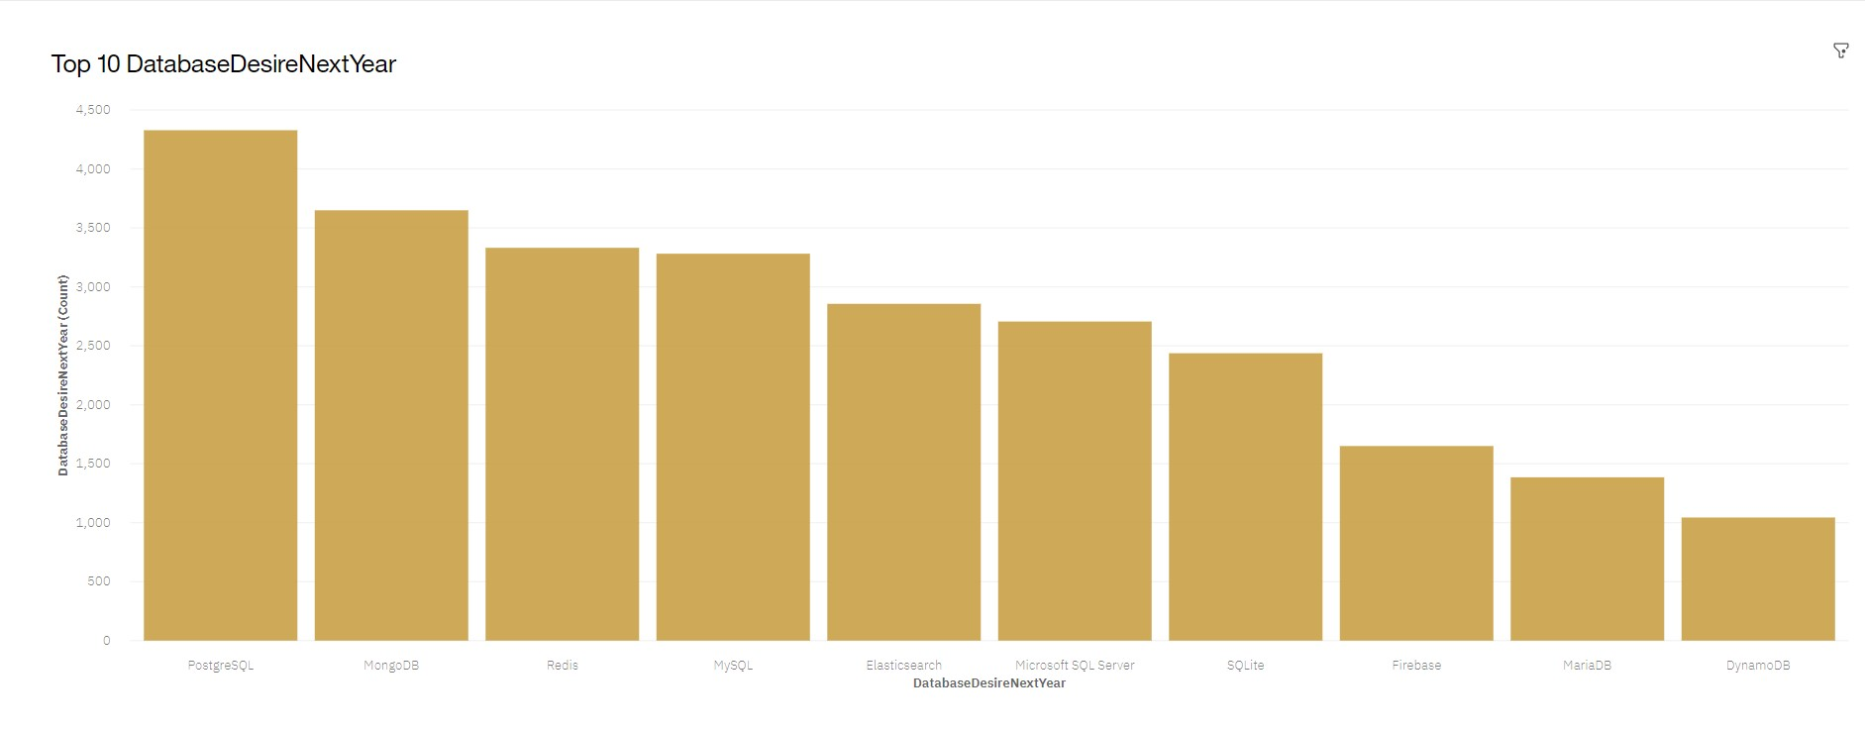
DATABASE TRENDS
Current Year
Next Year

Slide 10
DATABASE TRENDS - FINDINGS & IMPLICATIONS
Findings (insights)
MySQL most popular Behind Microsoft SQL
Elasticsearch, Redis & MongoDB comes out to show progressive trends in upcoming years whereas MySQL shows declining trend as compared to current-next years charts
Implications (What's comes Next)
PostgreSQL is becoming the new upcoming popular desired database skills among users replacing MySQL
Open-source databases are still preferable in companies
NoSQL databases will make an impact for storing non-relational data

Slide 11

DASHBOARD
DASHBOARD Link

Slide 12
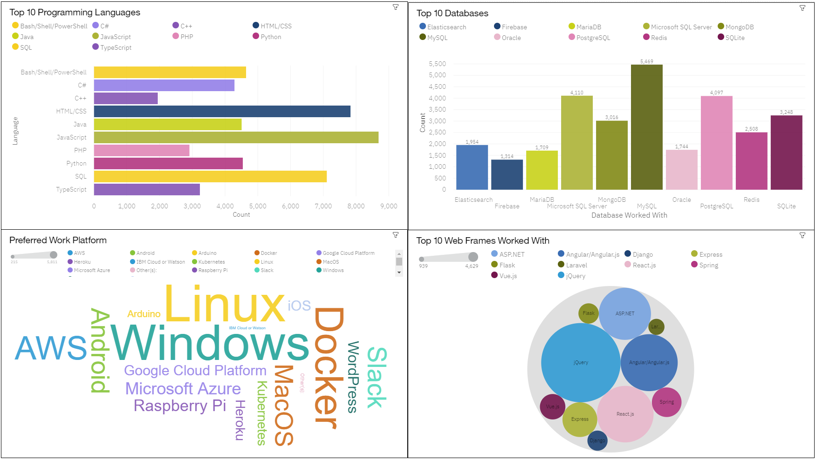
DASHBOARD TAB 1

Slide 13
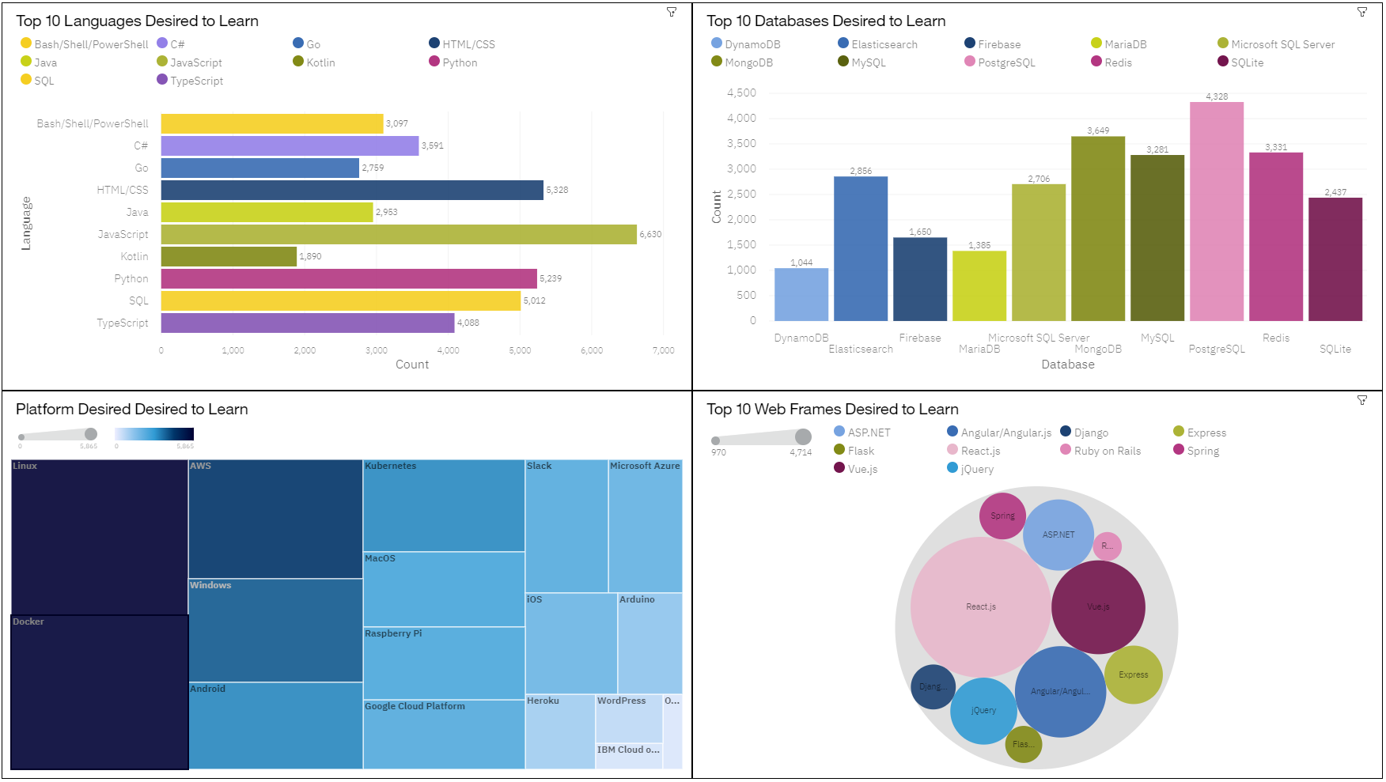
DASHBOARD TAB 2

Slide 14
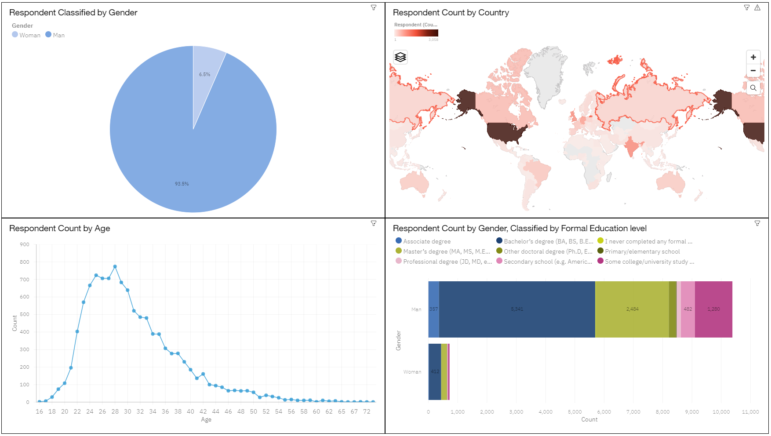
DASHBOARD TAB 3

Slide 15
DISCUSSION
Notes:
For this section you would begin to engage the audience with a discussion of your implications
that were drawn from the research.
For example, let’s say you were conducting research for top programming languages for
college graduates.
Would you find they need to learn multiple languages to remain competitive in the job
market, or would one language always reign supreme?

Slide 16
OVERALL FINDINGS & IMPLICATIONS
Findings
Fast changing technology every year
Platforms like Docker and AWS are growing
The upcoming trend for databases is non-relational databases mostly
Implications
People are looking for big data because it seem to have great future
People are looking for advanced programming languages with easy learning in focus
Companies need to be flexible and adjust to rapid changes

Slide 17

CONCLUSION
The top programming language in demand Present & Future is Java-script.
The top database skills in demand Present - MySQL , Future - PostgreSQL.
Popular Platform Present - Windows , Future - Linux Docker
The top Web-frame in Demand Present - jQuery , Future - React.js
Notes:
This final section should reiterate the problem given in the introduction and gives an overall
summary of the findings.
It would also state the outcome of the analysis and if any other steps would be taken in the
future

Slide 18

APPENDIX
Notes:
This section would contain information that really didn’t fit in the main body of the
report, but you deemed it was still important enough to include.
This type of information could include locations where the raw data was collected or other
details such as resources, acknowledgements or references

Slide 19
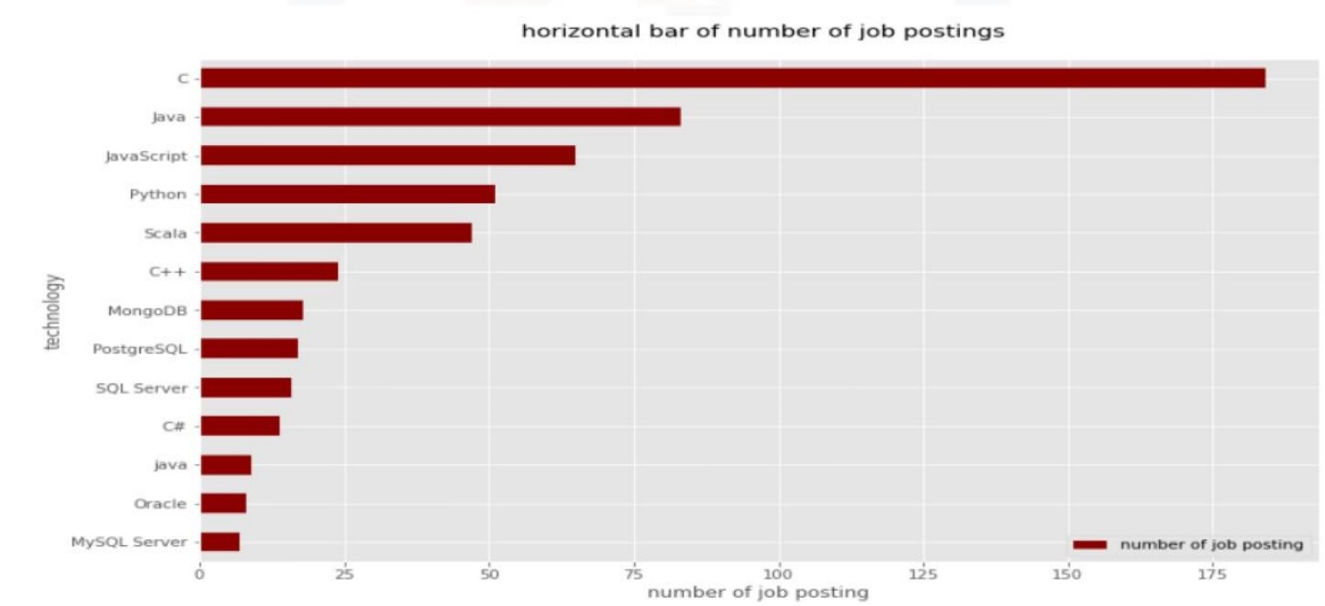
JOB POSTINGS

Slide 20
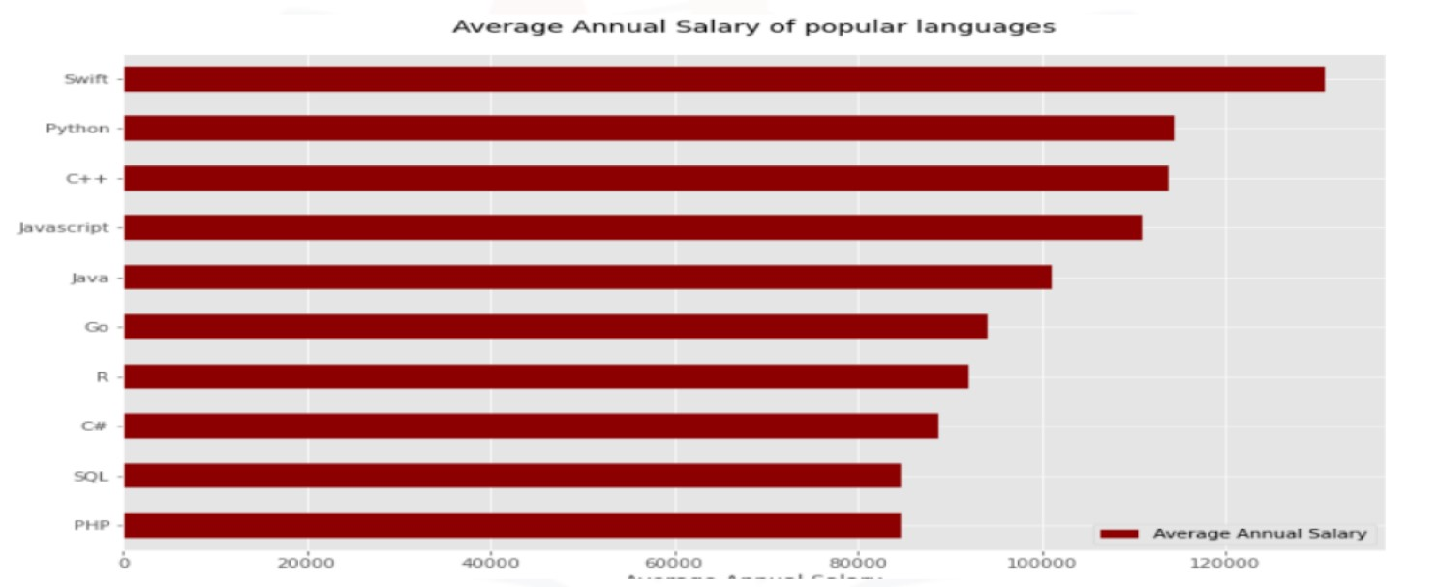
POPULAR LANGUAGES

